Slide 1


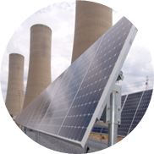
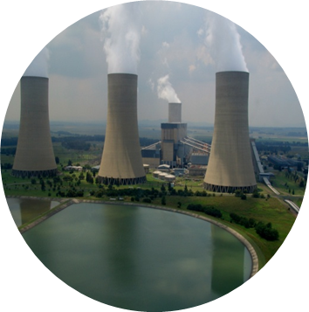
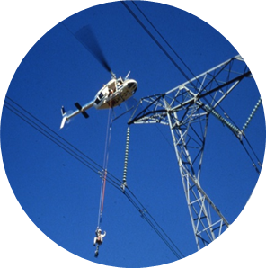

Transformers & Transformer Oil
Presented by: Teboho Richard Lekeno
Date: 18 May 2020

Slide 2
Presentation Outline/Overview
Transformer
1.1. What is transformer
1.2. Windings
1.3. Core
1.4. Bushing
1.5. Conservator tank
1.6. Pressure relief valve
1.7. Buchholz relay
1.8. Radiator & cooling fans
Transformer oil
2.1. Transformer oil functions
2.2. Dissolved gas analysis
2.3. Key gas method
2.4. Transformer diagnosing using individual and total dissolved key gas concentration
2.5. Rogers method of DGA

Slide 3
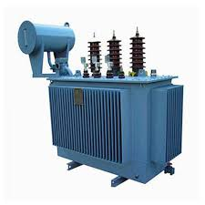
Purpose
Transformer
1. To transform power
2. Transmission – step-up
3. Distribution – step-down
Working principle
Electromagnetic induction
Mutual induction

Slide 4
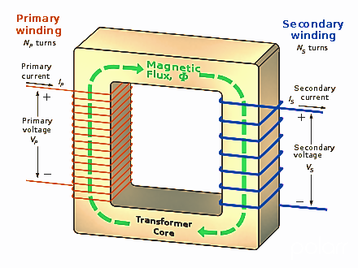
Purpose
Windings
Primary coil – excitation
Secondary coil – induction

Slide 5
Purpose
Core
Low reluctance path for flux
Links primary and secondary coils.
Induce secondary voltage

Slide 6
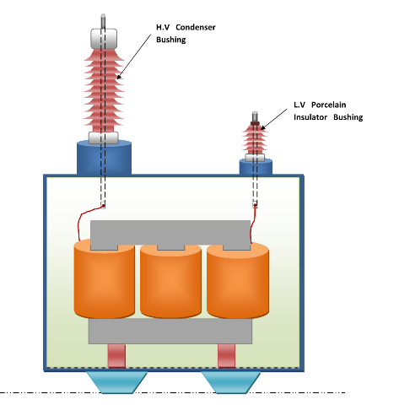
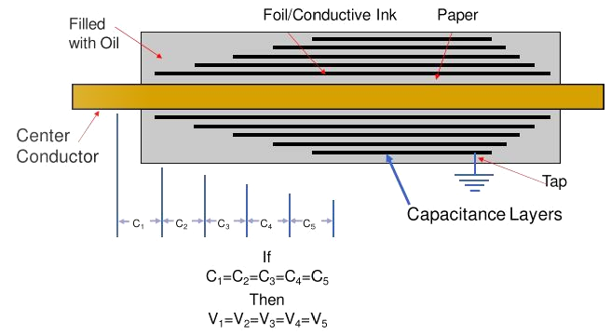
Purpose
Bushings
Path for live wire to the winding through grounded tank.
Working Principle
Series capacitors
Voltage divider
Phase to ground voltage
Filled oil

Slide 7
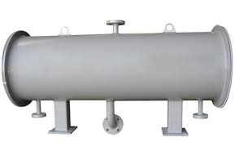
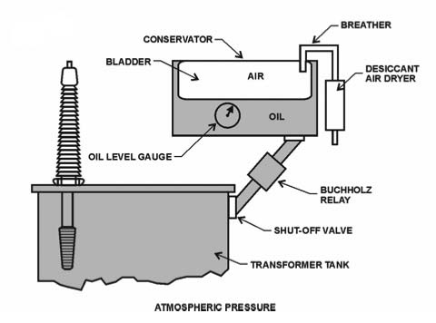
Purpose
Conservator Tank
Insulation oil reservoir
Allows transformer breathing

Slide 8
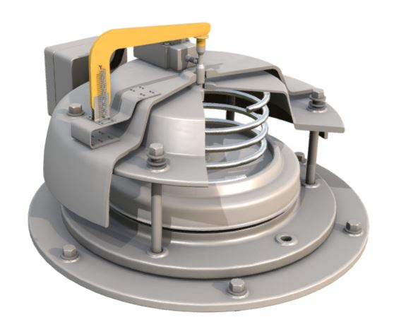
Purpose
Pressure Relief Valve
Pressure monitoring
Transformer tank protection
Internal fault detection
Working principle
Closes – pressure <= set pressure
Open – pressure > set pressure

Slide 9
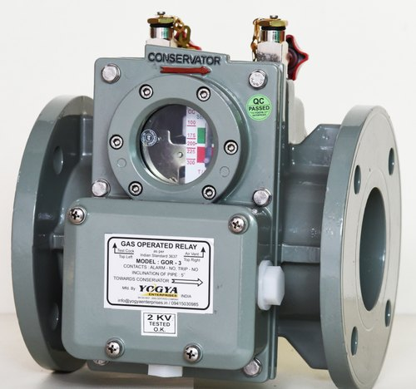
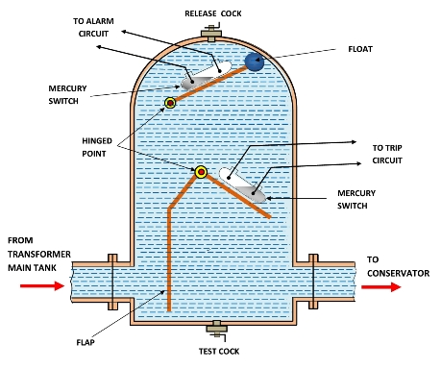
When does it operates?
Buchholz Relay
Purpose
Transformer internal faults protection
Located between MAIN and CONSERVATOR tank
Gas bubble formation
Transform oil level falls
Rapid oil flow

Slide 10
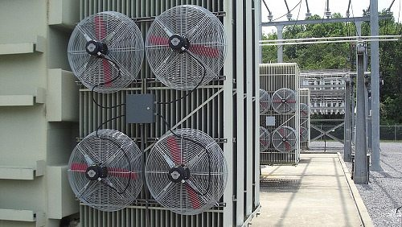
Purpose
Radiator & Cooling Fans
Radiator – oil cooling
Fans – fasten cooling process
Increases transformer loading

Slide 11
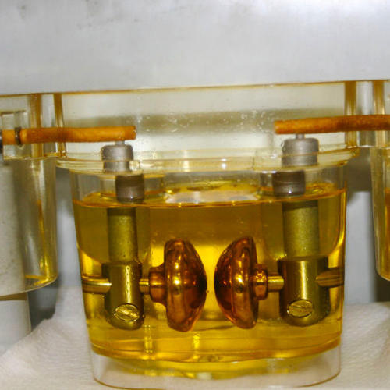
Purpose
Transformer oil
Insulation
Cooling
Extinguish arcs
Dissolve gases

Slide 13
Conclusion
….wrap up presentation and vac work period feedback from student

